Slide 1




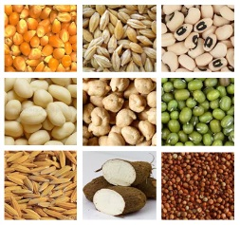

An initiative of the CGIAR
Generation
Challenge Programme (GCP)
BMS DMS Schema
Presented by:
Arllet M. Portugal
IBP Deployment Officer
Photo credit: Neil Palmer/CIAT

Slide 2
Concepts
Key elements of the Logical Data Model
for Phenotyping Data
The STUDY INFORMATION component records global contextual information about the experiment
The TRIAL ENVIRONMENT component manages all data values describing the environments observed in the study including georeference information, place names, growing environments, and overall management practices (non-treatment factors).
The GERMPLASM ENTRY component manages all label values describing the germplasm entries in the the experiment including local and global identifiers, names, sources and roles (check or test lines) of the entries.
Notes:
These elements are sufficient for managing phenotyping data from any field experiment, however a sixth component is required to facilitate integration of phenotyping data across studies. This is the Ontology Management System (OMS) which identifies comparable elements – labels, variates and values across studies.

Slide 3
Concepts
Key elements of the Logical Data Model
for Penotyping Data
The TRIAL DESIGN component manages the treatment and sampling design and structure of the datasets in the study.
The OBSERVATION component manages the values of the variates for each dataset.
Notes:
These elements are sufficient for managing phenotyping data from any field experiment, however a sixth component is required to facilitate integration of phenotyping data across studies. This is the Ontology Management System (OMS) which identifies comparable elements – labels, variates and values across studies.

Slide 4
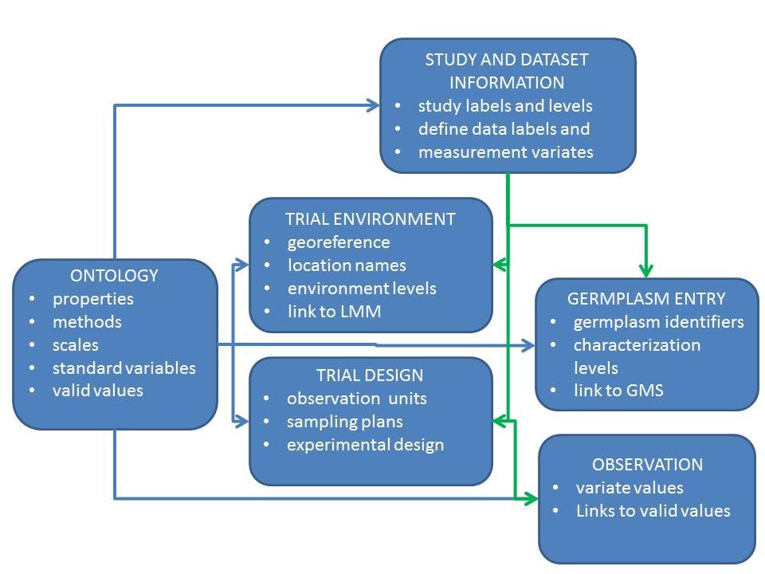
Concepts
Key elements of the Logical Data Model
for Penotyping Data
Notes:
These elements are sufficient for managing phenotyping data from any field experiment, however a sixth component is required to facilitate integration of phenotyping data across studies. This is the Ontology Management System (OMS) which identifies comparable elements – labels, variates and values across studies.

Slide 5
Concepts
Overview of the
ONTOLOGY MANAGEMENT SYSTEM
The Crop Ontology contains several controlled vocabularies (CV):
The PROPERTIES CV has terms describing the design and treatment factors applied in phenotyping experiments and the traits being measured in them.
The METHODS CV has terms describing the protocols by which those properties are applied or measured in phenotyping experiments.
The SCALES CV has terms describing the scales or units in which the values of the properties are recorded.
The STANDARD VARIABLES CV has terms defined by combinations of one property term, one method term and one scale term which describe the variables recording the design and observations of phenotyping experiments.
Notes:
These elements are sufficient for managing phenotyping data from any field experiment, however a sixth component is required to facilitate integration of phenotyping data across studies. This is the Ontology Management System (OMS) which identifies comparable elements – labels, variates and values across studies.

Slide 6
Concepts
Overview of CHADO
Chado is one of the relational databases that are used in GMOD
Its tables are broken down into groups called modules
Chado has been designed to allow extensibility
Chado is also ontology-aware. One could state this even more forcefully: Chado depends on ontologies.
Source: http://gmod.org/wiki/Overview
Notes:
These elements are sufficient for managing phenotyping data from any field experiment, however a sixth component is required to facilitate integration of phenotyping data across studies. This is the Ontology Management System (OMS) which identifies comparable elements – labels, variates and values across studies.

Slide 7
Concepts
CHADO Modules
Audit - for database audits
Companalysis - for data from computational analysis
Contact - for people, groups, and organizations
Controlled Vocabulary (cv) - for controlled vocabularies and ontologies
Expression - for summaries of RNA and protein expresssion
General - for identifiers
Genetic - for genetic data and genotypes
Library - for descriptions of molecular libraries
Notes:
These elements are sufficient for managing phenotyping data from any field experiment, however a sixth component is required to facilitate integration of phenotyping data across studies. This is the Ontology Management System (OMS) which identifies comparable elements – labels, variates and values across studies.

Slide 8
Concepts
CHADO Modules
Mage - for microarray data
Map - for maps without sequence
Organism - for taxonomic data
Phenotype - for phenotypic data
Phylogeny - for organisms and phylogenetic trees
Publication (pub) - for publications and references
Sequence - for sequences and sequence features
Stock - for specimens and biological collections
Notes:
These elements are sufficient for managing phenotyping data from any field experiment, however a sixth component is required to facilitate integration of phenotyping data across studies. This is the Ontology Management System (OMS) which identifies comparable elements – labels, variates and values across studies.

Slide 9
Concepts
CHADO Modules
Controlled Vocabulary (cv) - for controlled vocabularies and ontologies
Phenotype - for phenotypic data
Stock - for specimens and biological collections
Notes:
These elements are sufficient for managing phenotyping data from any field experiment, however a sixth component is required to facilitate integration of phenotyping data across studies. This is the Ontology Management System (OMS) which identifies comparable elements – labels, variates and values across studies.

Slide 10
Concepts
CHADO Natural Diversity Modules
The Chado Natural Diversity Module is an extension to the Chado schema to better support natural diversity data (phenotypic).
Under development
Source: http://gmod.org/wiki/Chado_Natural_Diversity_Module
Notes:
These elements are sufficient for managing phenotyping data from any field experiment, however a sixth component is required to facilitate integration of phenotyping data across studies. This is the Ontology Management System (OMS) which identifies comparable elements – labels, variates and values across studies.

Slide 11
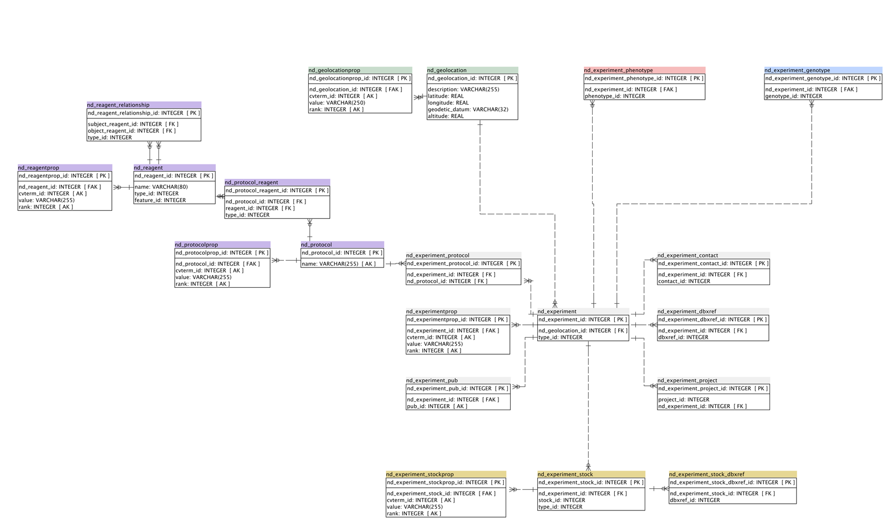
CHADO ND MODULE
ND_geolocation
ND_experiment_phenotype
ND_experiment

Slide 12
New DMS Schema
CHADO MODULES
Controlled Vocabulary (cv)
Phenotype
Stock
CHADO ND MODULE tables
ND_geolocation
ND_experiment tables
ND_experiment_phenotype
Notes:
These elements are sufficient for managing phenotyping data from any field experiment, however a sixth component is required to facilitate integration of phenotyping data across studies. This is the Ontology Management System (OMS) which identifies comparable elements – labels, variates and values across studies.

Slide 13
Concepts
Key elements of the Logical Data Model
for Penotyping Data
Project, projectprop,
Project_relationship
nd_geolocation,
nd_geolocationprop
Stock, stockprop
cv, cvterm, cvtermsynonym, cvterm_relationship
Phenotype
nd_experiment, nd_experiment_stock, nd_experiment_projectnd_experimentprop
Notes:
These elements are sufficient for managing phenotyping data from any field experiment, however a sixth component is required to facilitate integration of phenotyping data across studies. This is the Ontology Management System (OMS) which identifies comparable elements – labels, variates and values across studies.

Slide 14
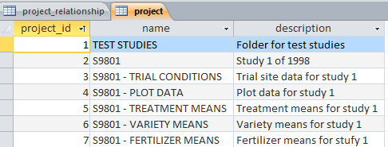
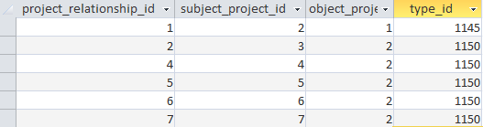
Studies and Datasets
STUDIES and DATASETS are captured using the CHADO project tables
The structure of folders, sub-folders, studies and datasets in managed through the project_relationship table
type_id => cvterm_id=1140 : “is a sub-folder of”,
cvterm_id=1145 : ‘is a study in’ and
cvterm_id=1150: “is a dataset of”,

Slide 15
Projectprop
Every study variable in a study is described by three records in the projectprop table with projectprop.project_id equal to the project_id of the study describing the user-supplied name, the user-supplied description of the variable and the cvterm_id of the standard variable to which it belongs.
The projectprop.type_id field indicates whether the projectprop.value contains a local name for the variable and if so, where it is stored in the schema, or whether it contains a description (type_id=1060) or the link to a standard variable (type_id=1070).
All projectprop records for the same label have the same projectprop.rank in the projectprop table. The rank specifies the user-supplied order of the variables in the study.

Slide 16
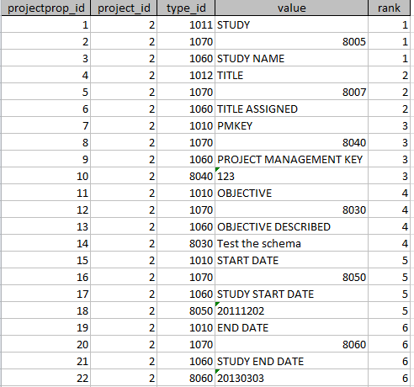
Projectprop for study information

Slide 17
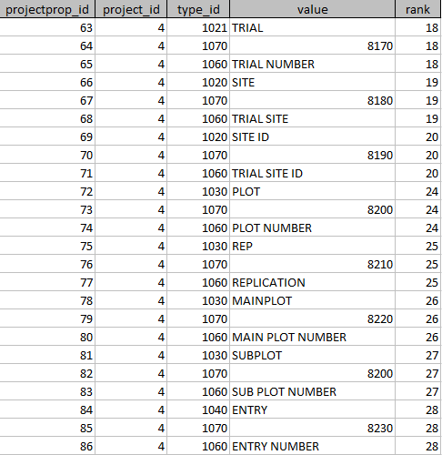
Projectprop for variables of datasets
All other variables (labels and variates) in the study belong to one or more datasets and these are described in projectprop records, in the same way as study variables, for each dataset in which they occur.

Slide 18

Trial Environment
The location/environment component of the logical data model manages information about the trial environment where an experiment is conducted. It uses the nd_geolocation table and nd_geolocationprop table to store all values of location labels. Information in these tables corresponds to actual physical locations where Field Trials are conducted.
The nd_geolocation.description field is used to store the value of factor with property TRIAL INSTANCE, method ENUMERATED and scale NUMBER.
Put all LOCATION labels in the nd_gelocationprop table
In the BMS field book file, those under the CONDITIONS section labeled by Trial, should be stored in the nd_geolocationprop.

Slide 19
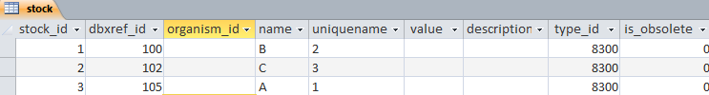
Germplasm Entries
The stock table maps to the Germplasm component of the logical data model. Entries in the stock table represent the Germplasm used in a field trail. Information about the Germplasm is stored in the GMS database, outside the scope of the Phenotyping database.
The stock.uniquename field is used to store the label with property GERMPLASM ENTRY, method ENUMERATED and scale NUMBER (ENTRY_NO, cvterm_id=8230) this is always present if the study comes from the BMS
If there is a label with property GERMPLASM ID, nethod ASSIGNED and scale DBID (GID, cvterm_id=8240) this contains the GID from GMS and they should be stored in the stock.dbxref_id field. Else null.
If there is a label with property GERMPLASM ID, method ASSIGNED and scale DBCV (DESIGNATION, cvterm_id=8250) it contains a germplasm name from the database and its levels should be stored in the stock.name field. Else null.
If there is another label with property GERMPLASM ID, method ASSIGNED and scale CODE (ENTRY_CODE, cvterm_id=8300) it contains a study level entry code for the germplasm and its levels should be stored in the stock.value field and its cvterm_id in the stock.type_id field. Else both are null.

Slide 20
Stockprop
The stockprop table contains levels of any other labels with relationship ‘stored in’ (cvterm_id=1044) pointing to ‘Germplasm entry’ (cvterm_id=1040) for example other names or whether a certain seed is a control/check in a field trial, or its seed source - where you got the seed or a label for the pedigree

Slide 21
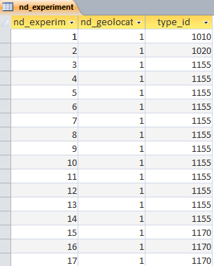
Trial Design
The Field Trial component of the Logical Data Model uses the nd_experiment tables. The information stored in the nd_experiment and supporting tables describes the design of the nursery or field trial and/or the structure of derived data coming from summary processes or statistical analysis.
Information on environments used in the study is provided by links to the nd_geolocation table
Each record in the nd_experiment table corresponds to one observation unit in a dataset

Slide 22
Trial Design
Each observation unit has a type indicated by nd_experiment.type_id linking to cvterm. Some types are:
Type = Study (cvterm_id=1010) linking levels of labels which apply to the whole study (like the PI’s name) to observations which might have been made at the whole study level – like water condition eg irrigated or not.
Type = Dataset (cvterm_id=1015) linking levels of the whole dataset environment to observations made at this level.
Type = Trial Environment (cvterm_id=1020) linking levels of labels which apply to each instance of a trial (ie each environment where a trail is repeated). Usage of properties is similar to study above.
Type =Field Plot (cvterm_id=1155). A field trial. Linked by proj_id (to what?) and links into the stock table. The properties describe the plot. Raw observations are linked from here in the phenotype table.
Type=Sample. (cvterm_id=1160) For a sample unit smaller than a plot
Type = Average (cvterm_id=1170). Linked by proj_id, links to the stock table, properties determined by what is being tracked. Means are linked from here in the phenotype table.
Type = Summary (cvterm_id=1180) for summary statistics like SEs and LSDs. Linked by proj_id, links to the stock table, properties similar to plot.

Slide 23
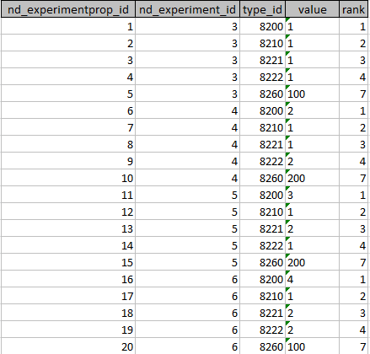
Nd_experimentprop
Levels of other labels describing the experiment context are supplied in the nd_experimentprop table and these are linked to their standard variable ID via the nd_experimentprop.type_id.
cvterm_id | name | definition
8200 | PLOT_NO | Field plot - enumerated (number)
8210 | REP_NO | Replication - assigned (number)
8221 | SUB_BLOCK | Sub-block or incomplete block in a field design - assigned (number)
8222 | SUB_PLOT | Sub-plot sampling unit within a field plot -assigned (number)
8260 | NFERT_TREAT | N fertilizer treatment - applied (kg/ha)

Slide 24
Nd_experiment linkages
Each observation unit (nd_experiment record) belongs to a project (study or dataset) and this is recorded in the nd_experiment_project table
Each nd_experiment record links to Trial Environment and Location labels via the nd_experiment.nd_geolocation_id field.
Details of the germplasm applied to each nd_experiment record are linked via the nd_experiment_stock linkage table which allows many to many linkages between nd_experiment records and stock records although in the breeding context this will almost always be one stock to many observation units (nd_experiment records).
All phenotype records are linked to the appropriate nd_experiment record via the nd_experiment_phenotype linkage table

Slide 25


The Observation
Variate values (or observed values) are recorded in the phenotype table.
All phenotype records are linked to the appropriate nd_experiment record via the nd_experiment_phenotype linkage table.
The variate value is stored in the phenotype.value field whether it is numeric or character except for categorical variates for which the valid values are stored in the cvterm table and the actual value is indicated by a link from phenotype.cvalue_id
The phenotype.observable_id field links the phenotype value to the standard variable (STDVAR) cv term in the cvterm table. The phenotype.name field also stores the cvterm id for the standard variable so that links can easily be made to the standard variable id in the projectprop table when browsing datasets.

Slide 26
Controlled Vocabulary (CV) Related tables
CV –contains the different CV used in cvterm table
1010 – CV for Trait or Property
1020 – CV for Methods
1030 – CV for Scale
1040 – CV for Standard Variables
Cvterm – contains the terms of the CVs used in BMS DMS

Slide 27
Standard Variable
A standard variable has a minimum of 6 relationships specified in cvterm_relationship. The type_id field specifies the type of relationship
The value of object_id is a cvterm_id from the ff sources
When Type_id = 1225, get the appropriate cvterm_id from Table 4
When type_id = 1044, get the appropriate cvterm_id from Table 6
When type_id = 1105, get the appropriate cvterm_id from Table 5
When type_id=1200 (property), get the appropriate cvterm_id under cv = 1010
When type_id = 1210 (method), get the appropriate cvterm_id under cv = 1020
When type_id=1230 (scale), get the appropriate cvterm_id under the cv = 1030
id | type_id | subject_id | object_id | interpretation of the relationship type | name of the related term
2420 | 1225 | 8250 | 1087 | 8250 is a | GERMPLASM TERM
3250 | 1044 | 8250 | 1040 | 8250 stored in | ENTRY ELEMENT
6560 | 1105 | 8250 | 1120 | 8250 has type | CHARACTER VARIABLE
8240 | 1200 | 8250 | 2205 | 8250 has property | GERMPLASM ID
8242 | 1210 | 8250 | 4030 | 8250 has method | ASSIGNED
8244 | 1220 | 8250 | 6000 | 8250 has scale | DBCV
Note: The tables are in the document about Phenotyping DMS of IBDBV2

